Slide 1
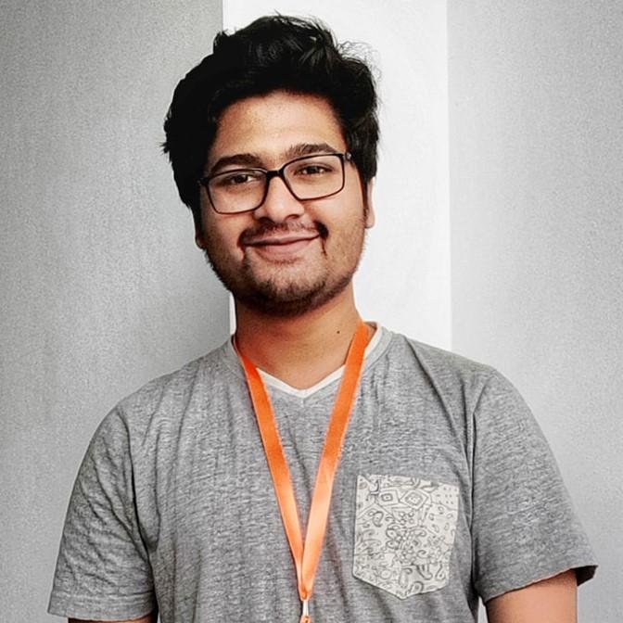
Internship Presentation by
ATIQ ISRAK NILOY
ID: 2016100000039
Batch: 43
Department of Computer Science & Engineering
Southeast University

Slide 2


REM Eco Savers Ltd.
Here is where your presentation begins

Slide 3


02
01
04
03
06
05
07
ABOUT US
OUR COMPANY
About the company and the directors
REM Ecosavers Ltd featuring covers
DivasnMenz
PRODUCTS
Sister Concern business
Products Pictures with Descriptions
WORK SOURCES
The development source codes and documentation
GOAL
The goal of my work
Gallery
Intern life gallery timeline

Slide 4

OUR COMPANY
REM Ecosavers Ltd. is a company that manufactures bioplastic products from natural ingredients like vegetables and fishes.

Slide 5

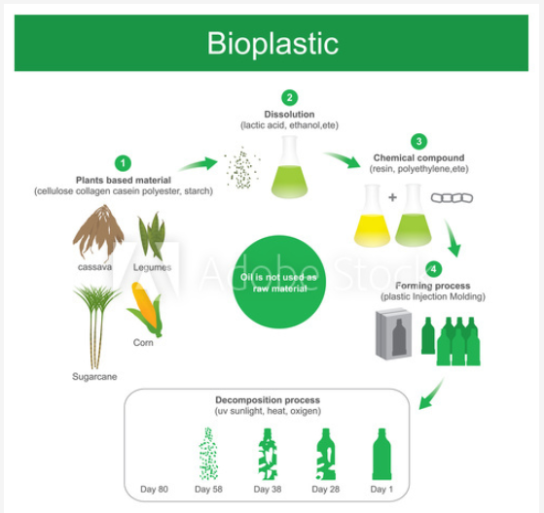
WHAT WE ARE WORKING ON

Slide 6
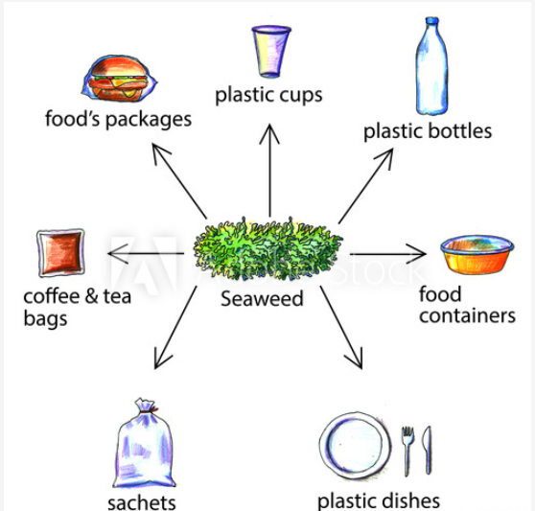
WHAT WE ARE WORKING ON

Slide 7

ABOUT US
Our goal is to manufacture bio-plastic products like plate, glass, spoon, fork, knife, poly bag and lot more daily appliance products that will replace the plastic products in the market.
We have started manufacturing the polybags initially to serve in the market. Later on, we will start manufacturing rest of the products by the end of 2020.

Slide 8
Internship
I am doing internship in this company as an IT Engineer. Initially my responsibilities are
Developing the official website of the company
Building an ERP for the production pipeline
Working with the team for the development of sister concern business organizations like
i. DivasnMenz (E-commerce fashion)
ii. Sardars (Daily appliance shopping)
Reporting directly to the managing director on decision making of the digital marketing of the company products

Slide 9

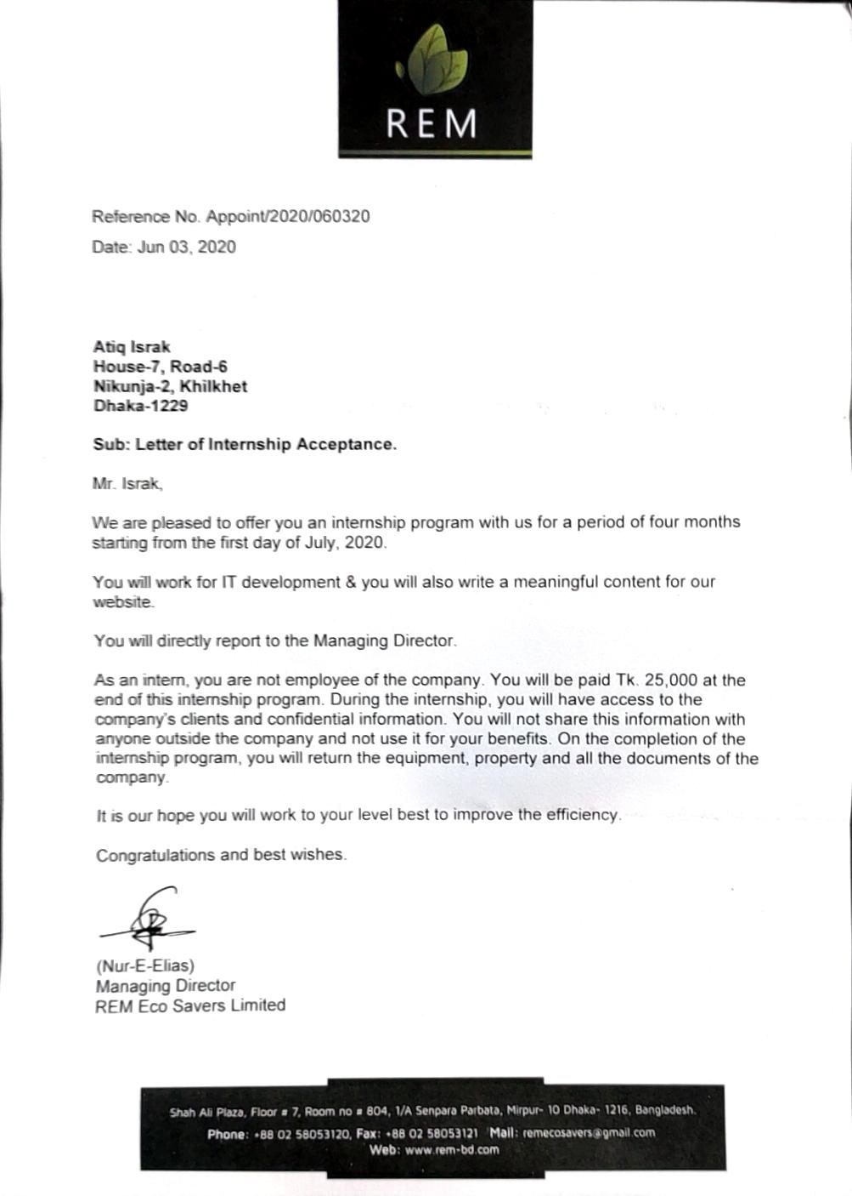

Appointment Letter and Visiting Card

Slide 10
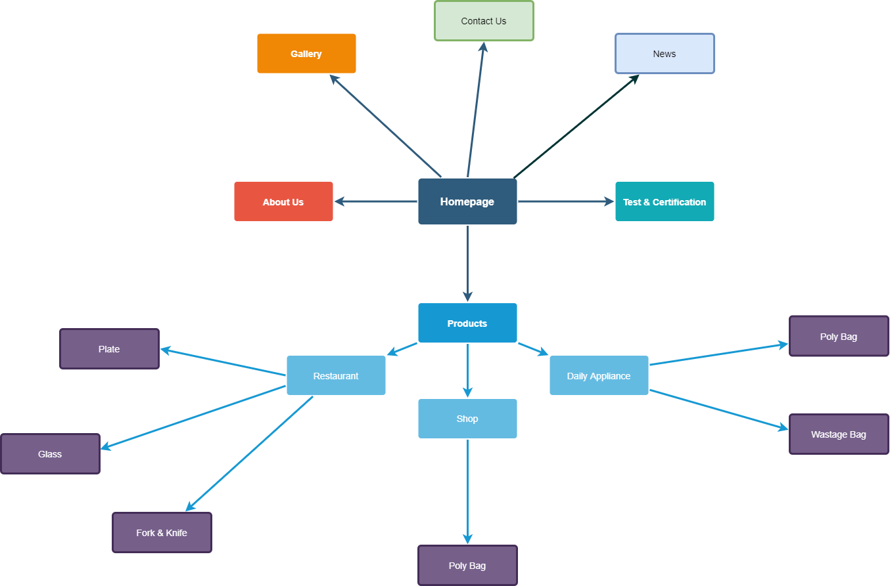
Site map

Slide 11
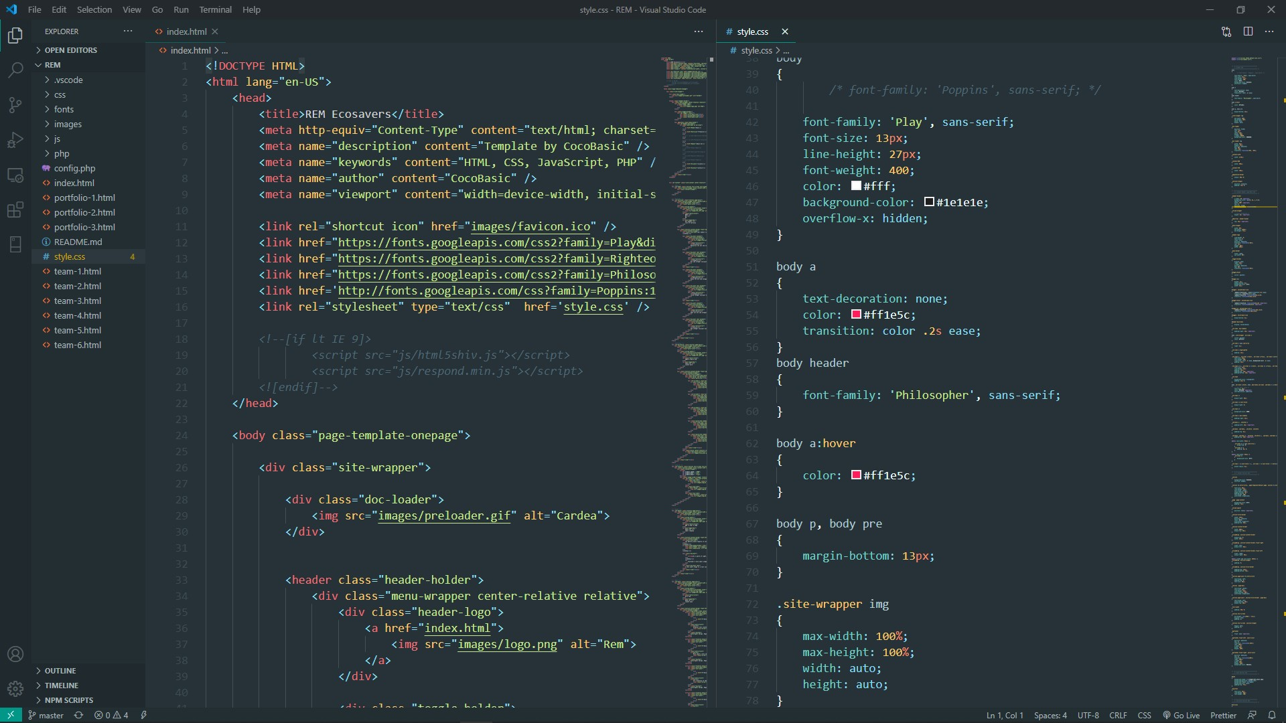
Source Code

Slide 12

Company Official Website

Slide 13

Eco-Friendly Biodegradable Products

Slide 14

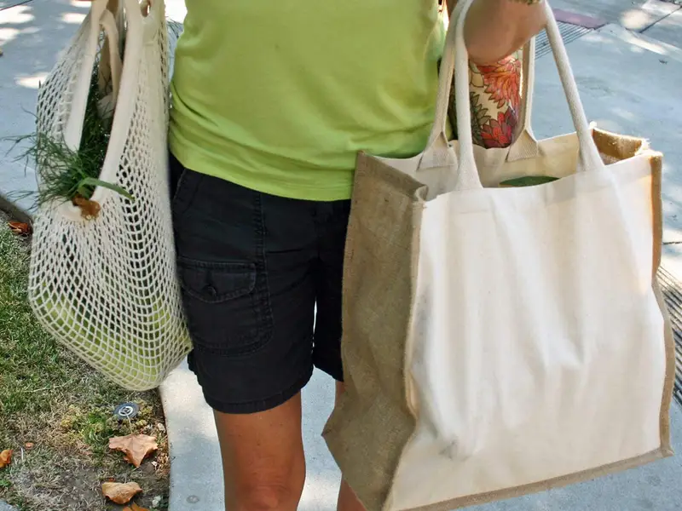
Washable Mesh Produce Bags
Shopping/Grocery Bags

Slide 15



Cutlery Products

Slide 16
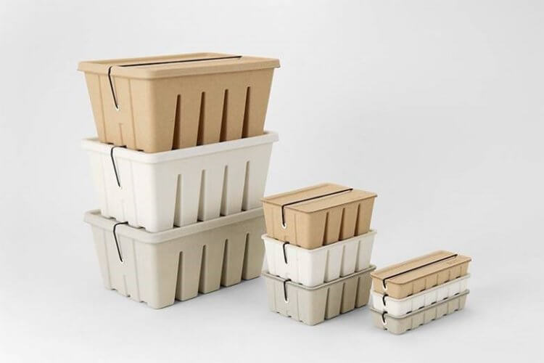
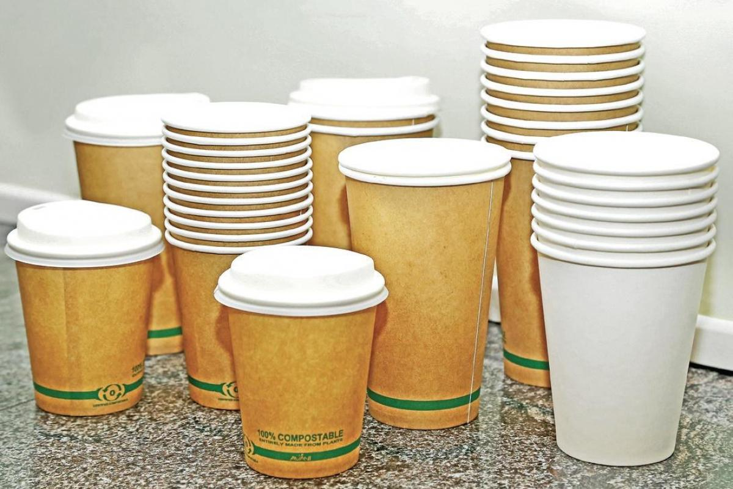
Boxes
One time glasses

Slide 17
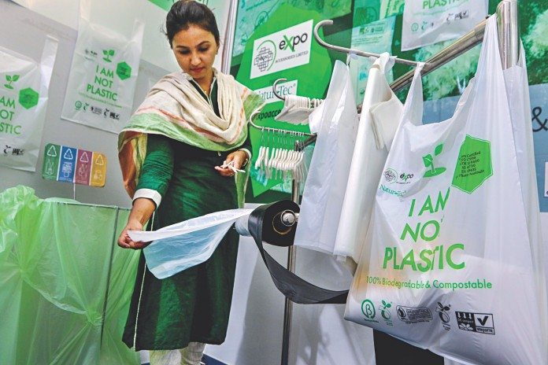


Compostable bag & Sack
Production line bags

Slide 18

DivasnMenz
A new generation E-Commerce place for new generation people

Slide 19
DivasnMenz
A new generation E-Commerce place for new generation people
DivasnMenz is an E-Commerce platform where one can find everything at one place

Slide 20
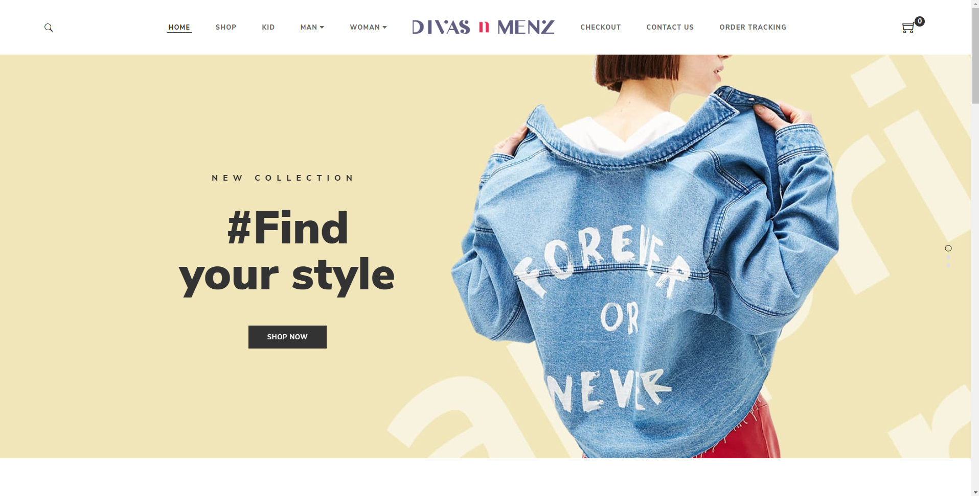
DivasnMenz Official Website

Slide 21
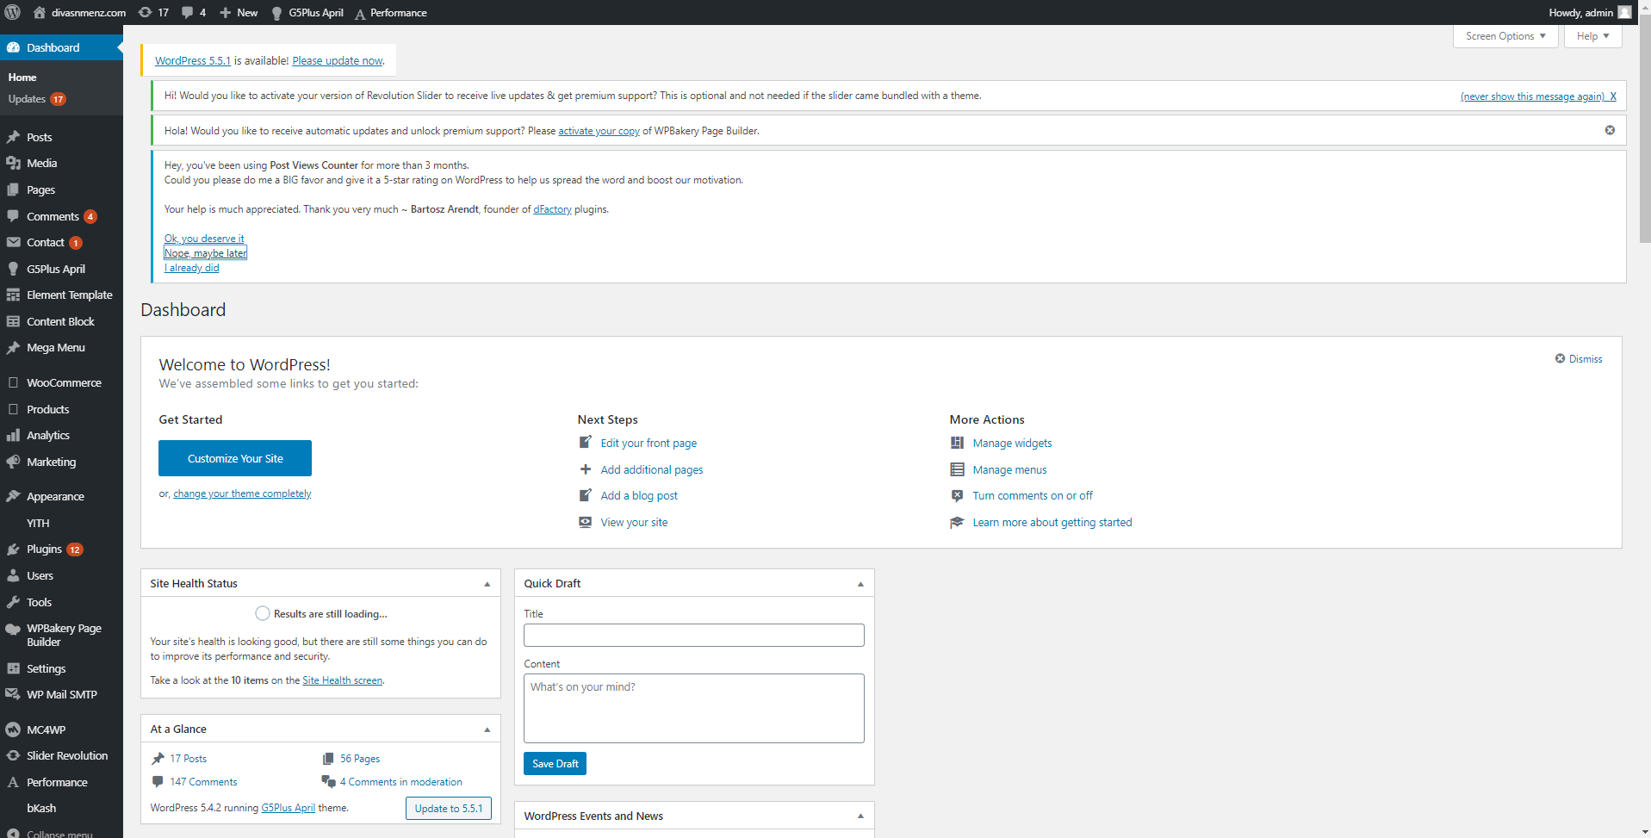
Wordpress Dashboard of Admin

Slide 22
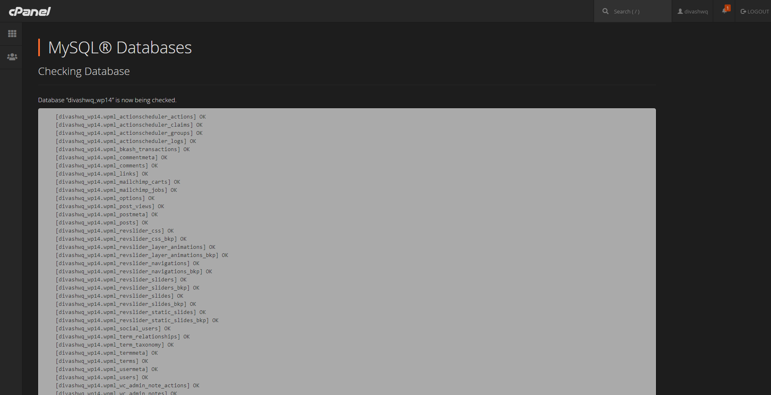
Database query

Slide 23
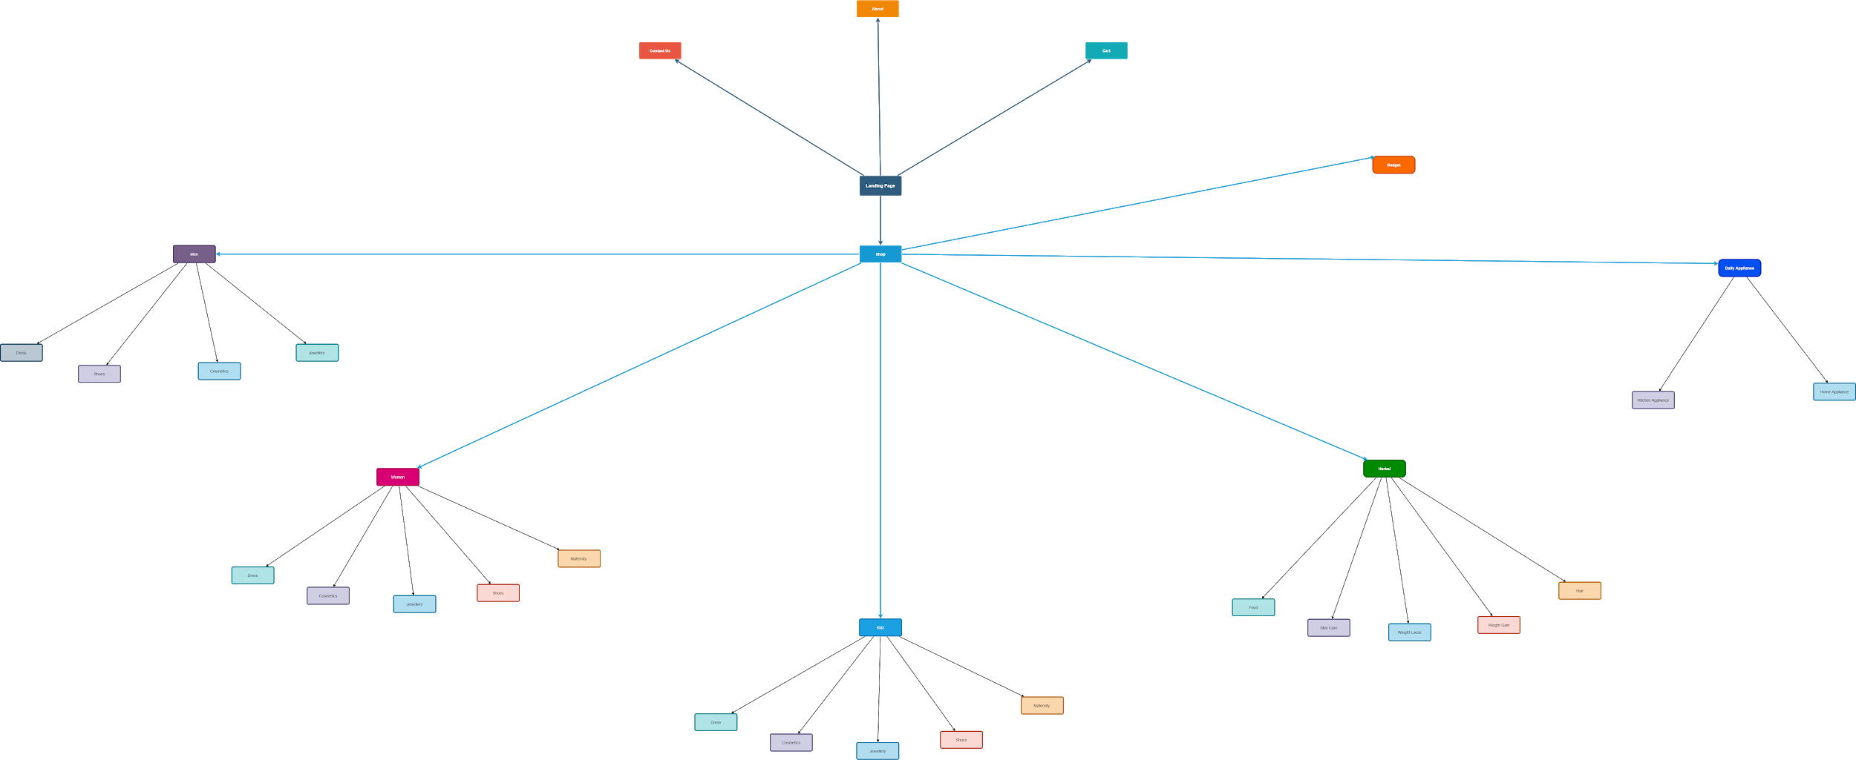
Site Map of DivasnMenz

Slide 24
GOAL
My goal is
Developing one of the best performed company official website for REM Ecosavers along with the industry ERP.
Making the DivasnMenz one of the leading E-Commerce platform in Bangladesh.

Slide 25
Gallery

Slide 26
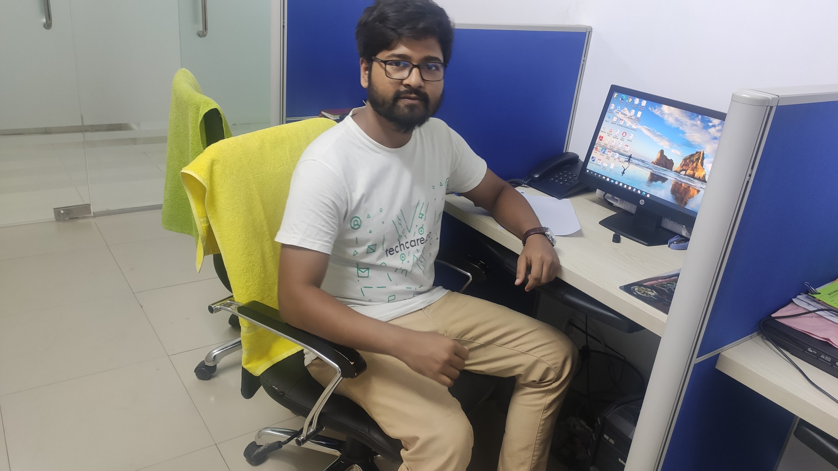

Slide 27
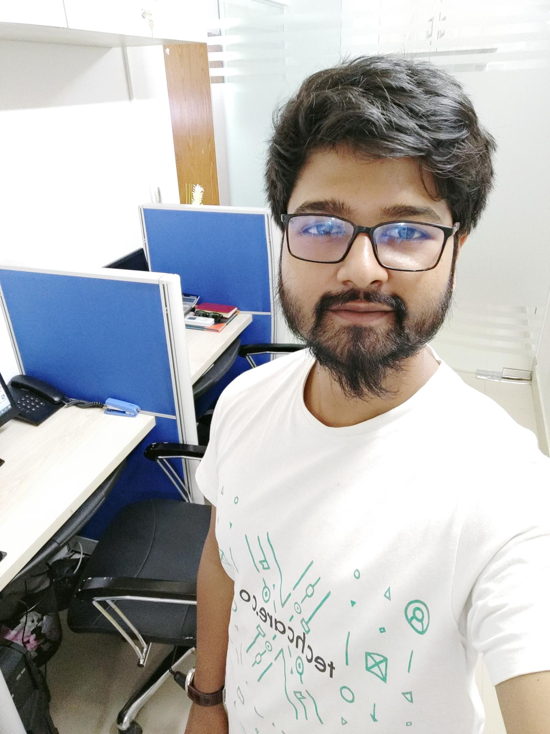
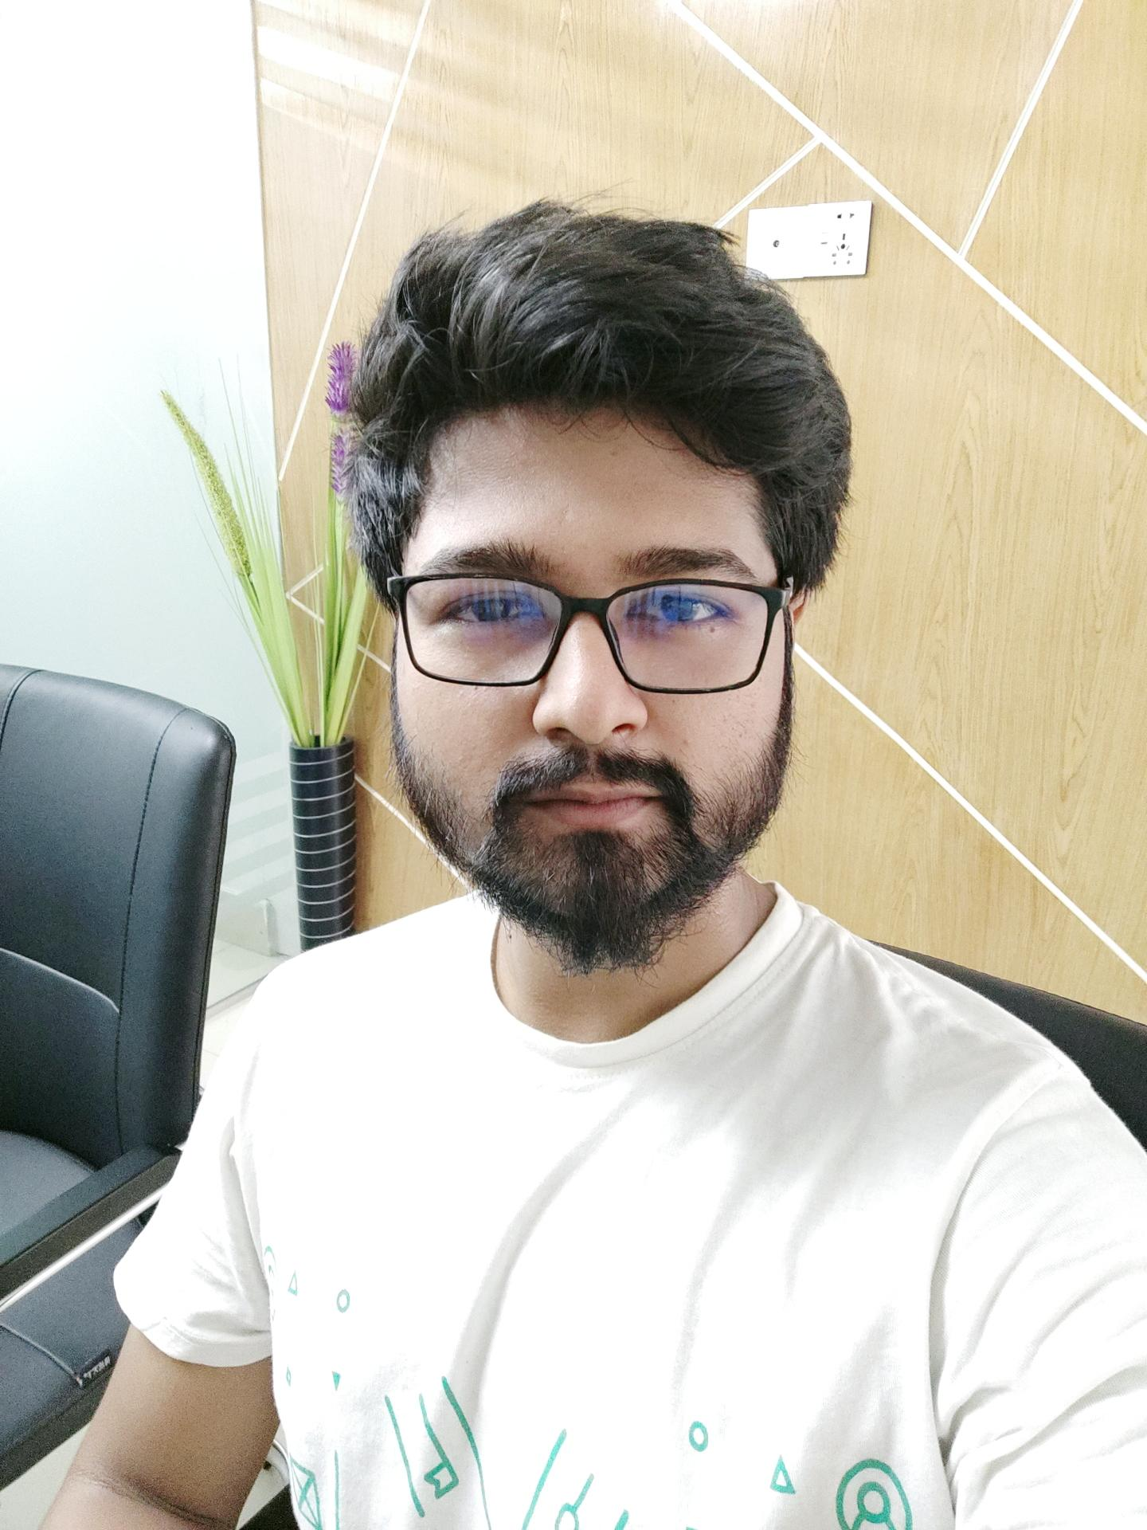

Slide 28

THANKS
For further query, feel free to mail
atiqisrak@gmail.com
+880 1701893882
rembd.netlify.app

